Slide 1









GOLD SPONSORS
SILVER SPONSORS
BRONZE SPONSOR
STRATEGIC PARTNER

Slide 2
Comparing Predictive Mining Models from R, Python, SSAS, and Azure ML
Dejan Sarka

Slide 3
Introduction
Dejan Sarka (dsarka@solidq.com, dsarka@siol.net, @DejanSarka)
30 years of experience
SQL Server MVP, MCT,…
16 books
15+ courses
Focus:
Data modeling
Data mining
Data quality

Slide 4
Agenda
Advanced analytics virtual cycle
Training and test sets
Evaluating predictive models
Classification (confusion) matrix and derivatives
Evaluating in SSAS, R, Python, and Azure ML models
Bringing it all together

Slide 5
Advanced Analysis Virtual Cycle
Advanced Analysis Virtuous Cycle
Identify
Transform
Measure
Act

Slide 6
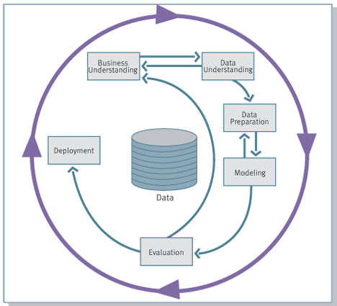
The CRISP Model
The CRISP Model
Transform
CRISP = Cross Industry Standard Process for Data Mining
(http://en.wikipedia.org/wiki/Cross_Industry_Standard_Process_for_Data_Mining)

Slide 7
Training and Test Sets
For predictive models, you need to split the data into training and test sets in order to evaluate the models
A training set is required to build the model (70% of the data)
A test set is used for predictions (30% of the data)
When you know the value of the predicted variable, you can measure the quality of the predictions
As with every sampling, it is important to randomly select the data for each set

Slide 8
Testing the Sampling
Test for randomness by creating the two samples and adding a variable that identifies whether a set is a training set or test set (or that identifies the sample)
Check the null hypothesis that the new variable is not related to other variables
Use one-way analysis of variance (ANOVA) and F-tests for continuous variables
Use chi-squared test for discrete variables
Can also use Decision Trees for discrete variables

Slide 9
Evaluating Predictive Models
Lift chart
Cross validation
Classification (confusion) matrix and derivatives

Slide 10
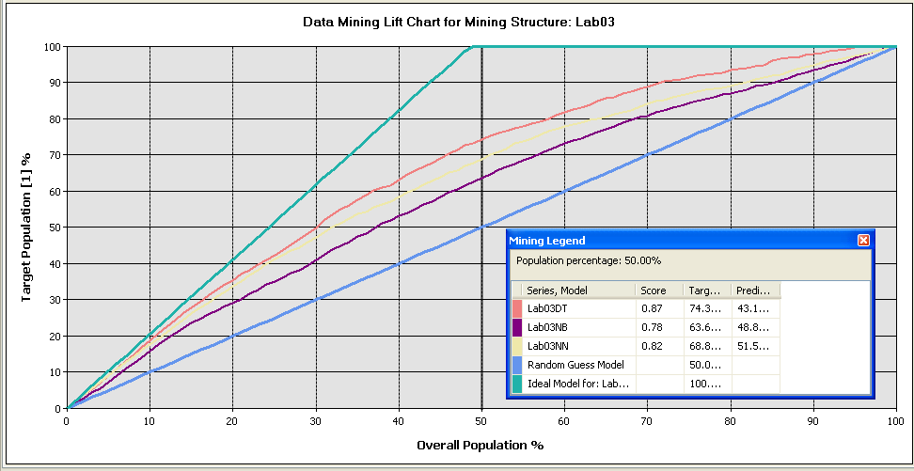
Lift Chart
No target value: overall performance
Target value: a percentage of the target audience against a specified percentage of the complete audience

Slide 11
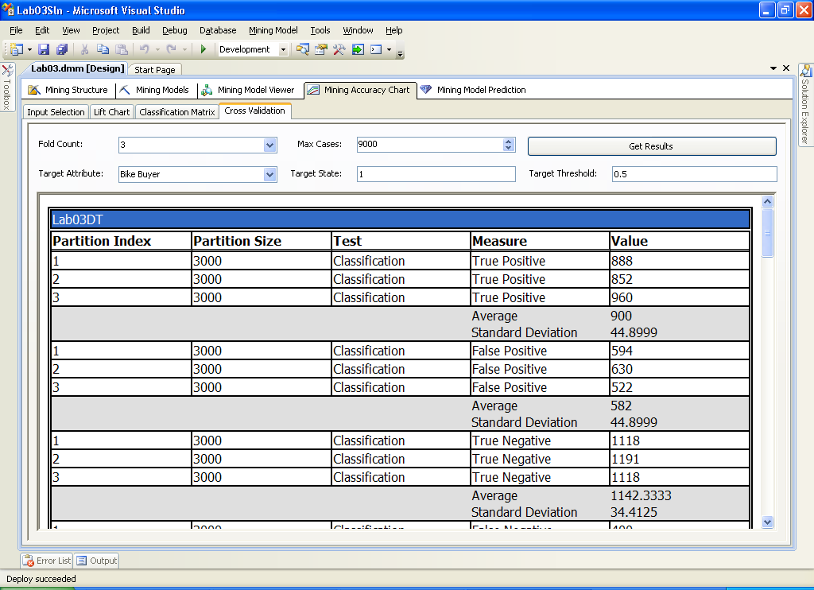
Cross Validation
Cross validation show robustness of models
Splits training set in folds
Use one fold for testing, others for training
You can see how models perform over different subsets of data

Slide 12
Classification (Confusion) Matrix
Columns represent items that have been predicted
Rows represent the actual state of the attribute
 |  | Predicted
 |  | Negative | Positive
Actual | Negative | TN | FP
 | Positive | FN | TP

Slide 13
Derivatives from Confusion Matrix
Sensitivity, recall, hit rate, or true positive rate (TPR)
Specificity or true negative rate (TNR)
Precision or positive predictive value (PPV)

Slide 14
Derivatives from Confusion Matrix
Negative predictive value (NPV)
Miss rate or false negative rate (FNR)
Fall-out or false positive rate (FPR)

Slide 15
Derivatives from Confusion Matrix
False discovery rate (FDR)
False omission rate (FOR)
Accuracy (ACC)

Slide 16
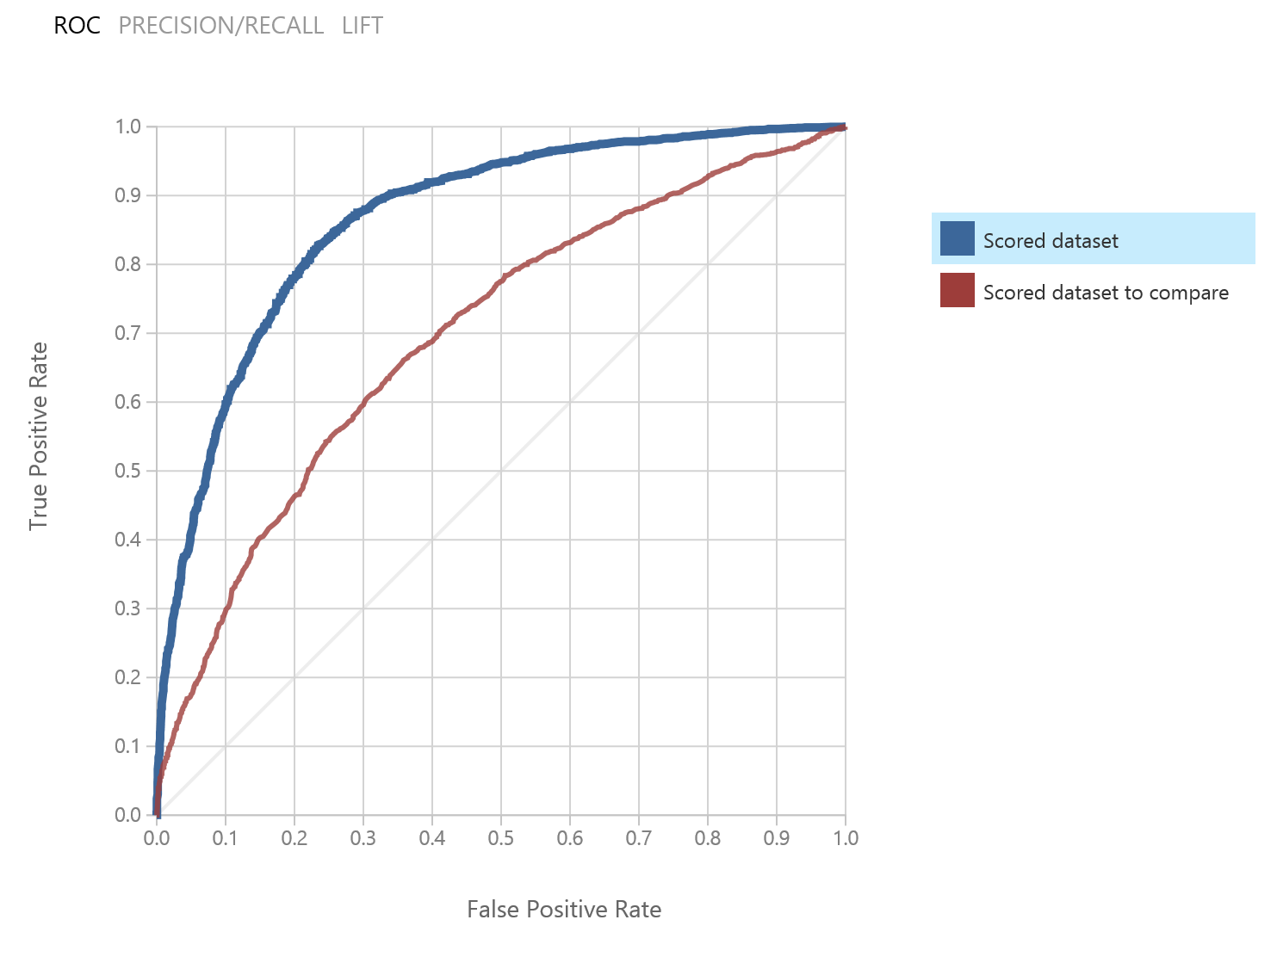
Derivatives from Confusion Matrix
Harmonic mean of precision and sensitivity (F1 score)
Receiver operating characteristic (ROC) curve
Plotting the true positive rate (TPR) against the false positive rate (FPR) at various threshold settings

Slide 17
Evaluating in SSAS, R, and Azure ML
SSAS
Lift chart
Cross-validation
Classification matrix (basic)
R, Python
Whatever you code☺
Azure ML
ROC
Classification matrix (partly)

Slide 18
Bringing It All Together
Use DMX (data mining extensions) query to browse SSAS mining models and perform predictions
Use T-SQL to execute R and Python code and return tabular format
sys. sp_execute_external_script (SQL Server 2016 and 2017)
PREDICT() function (2017 only, limited usability)
Use Azure ML Web services to get predictions from Azure ML models in your application or in Excel
Use SSIS to union all predictions and create a report

Slide 19
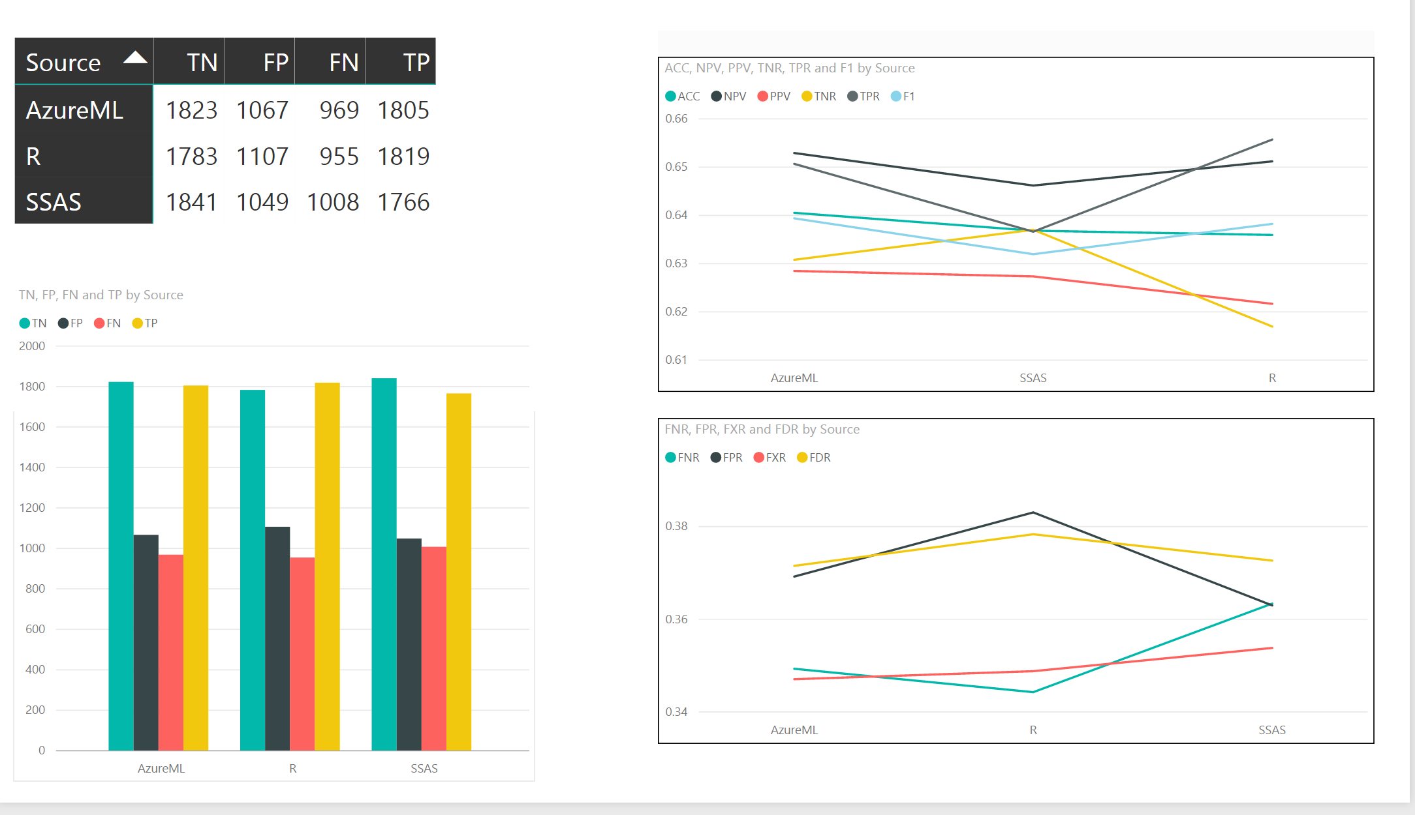
Bringing It All Together

